Slide 1

Analysis on Impact of Covid-19
Submitted By :- Vamsi Krishna Kanchukommala
Student Id: 11666316
Course: Scentific Data Visulization(CSCE 5320)

Slide 2
DOMAIN
COVID-19 is a global pandemic that has affected millions of lives worldwide, disrupting health systems, economies, and daily life. Understanding its spread and impact is crucial
The First Dataset Contains the data of Covid diseases spread across the world and the second dataset contains population of every country, area and density of countries
Analysis of COVID-19 data helps public health officials make informed decisions about lockdowns, social distancing measures, and healthcare resources allocation.
Through visualization and analysis, we can communicate complex data in an understandable way

Slide 3
DATA ABSTRACTION
First Data set includes statistics related to the COVID-19 pandemic for different locations across the world stored in a CSV.
Attributes:
Geographic Identifiers: iso_code, continent, location.
Temporal Data: date.
COVID-19 metrics: total_cases, total_deaths, total_cases_per_million, total_deaths_per_million, new cases etc
Vaccination data:total_vaccinations,people_vaccinated,people_fully_vaccinated
Health metrics: life_expectancy, cardiovasc_death_rate, diabetes_prevalence
Miscellaneous: stringency_index, gdp_per_capita, median_age, aged_65_older, aged_70_older etc

Slide 4
DATA ABSTRACTION
The Dataset has 67 attributes represents comprehensive information on Covid-19
The dataset contains a total of 166,326 records each representing a country's data for a specific date, indicating a detailed and granular temporal breakdown
The dataset has many missing fields such as Weekly ICU Admissions Per Million and Weekly ICU Admissions has 96.73% missing and excess Mortality metrics (cumulative, cumulative per million, and plain excess mortality): around 96.57% missing fields etc
The data needs to transformed and cleaned before proceeding with analysis

Slide 5
DATA ABSTRACTION
Second data set focus on population statistics for various countries, including historical, current, and projected population figures
Attributes:
Geographic identifiers: country, cca2 , cca3
Ranking and Area: rank, area , landAreaKm
Population Change and Density: netChange , growthRate, worldPercentage , density , densityMi
Historical and Projected Populations: pop1980, pop2000, pop2010, pop2022, pop2023, pop2030, pop2050
Miscellaneous: place

Slide 6
DATA ABSTRACTION
The Dataset has 16 attributes represents population statistics for various countries
The dataset contains a total of 238 records each representing a country's population data
These Two datasets after cleaning has to merge the 'country' column can be used as a key for merging with the cleaned COVID-19 data
Merging this population dataset could enrich the COVID-19 data with additional context, such as understanding how population density might correlate with case spread and fatality rates.

Slide 7
Task Classification
The Tasks are to clean the existing data and merge the dataset with the population Data.
Removal of Date-Specific Entries: Date columns were removed, focusing the dataset on country-level aggregations.
Handling of Missing Data: Rows and columns with significant amounts of missing data, such as 'weekly_icu_admissions' or 'weekly_hosp_admissions', were either removed or cleaned to ensure the quality of analyses.
Selection of Relevant Columns: Only 16 crucial columns were retained, focusing on aggregate statistics rather than daily updates and more granular temporal data.

Slide 8
Task Classification
Results of Actions:
Covid Dataset is consists of Time based data. By Keeping the latest Entry of each country the cleaned dataset has only 238 records
Removing the attributes with high null values we de cluttered the data and results in 16 attributes
Once the Covid data is cleaned, I merged with the population data.
Merging the datasets on the "location" field yielded only 210 entries while with cca3 yielded in 220 entries
There are 35 attributes including country demographics (population, area, growth rate), geographic identifiers (ISO codes, continent), and health metrics (COVID-19 cases and deaths, population density, median age, GDP per capita, etc.).

Slide 9
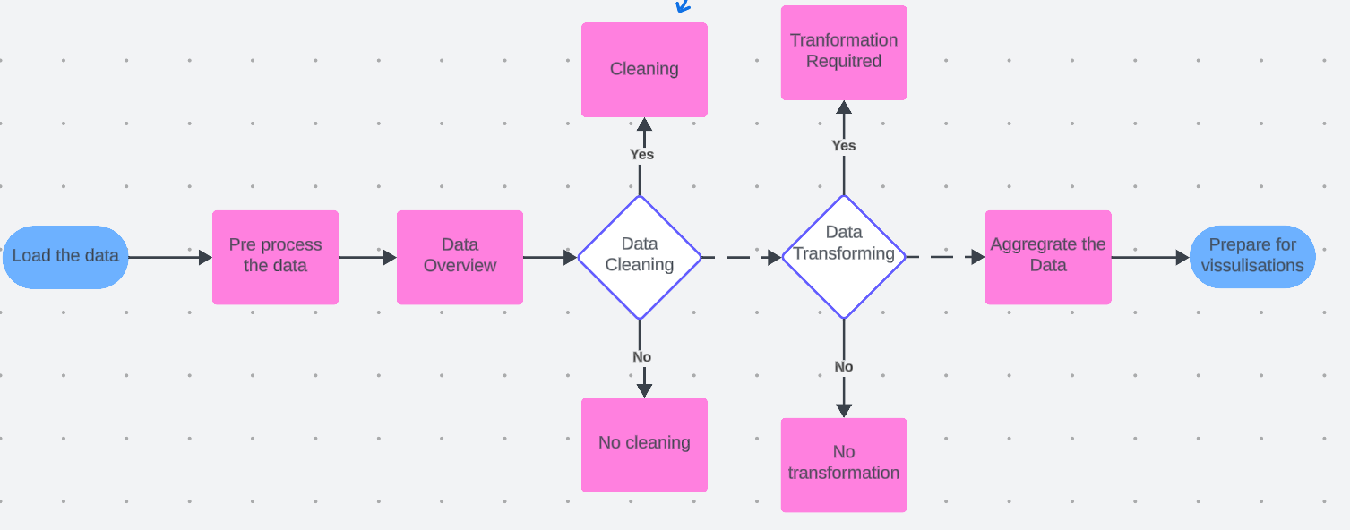
Task Classification

Slide 10
Graph-1: Total COVID-19 Cases Across the World
Tool Used: Tableau
This geographic visualization maps the total number of COVID-19 cases across the world, with countries represented as circles sized proportionally to the total cases they have reported.
Tableau is highly effective for making detailed and attractive visualizations. Supports extensive data manipulation and complex dashboards.

Slide 11
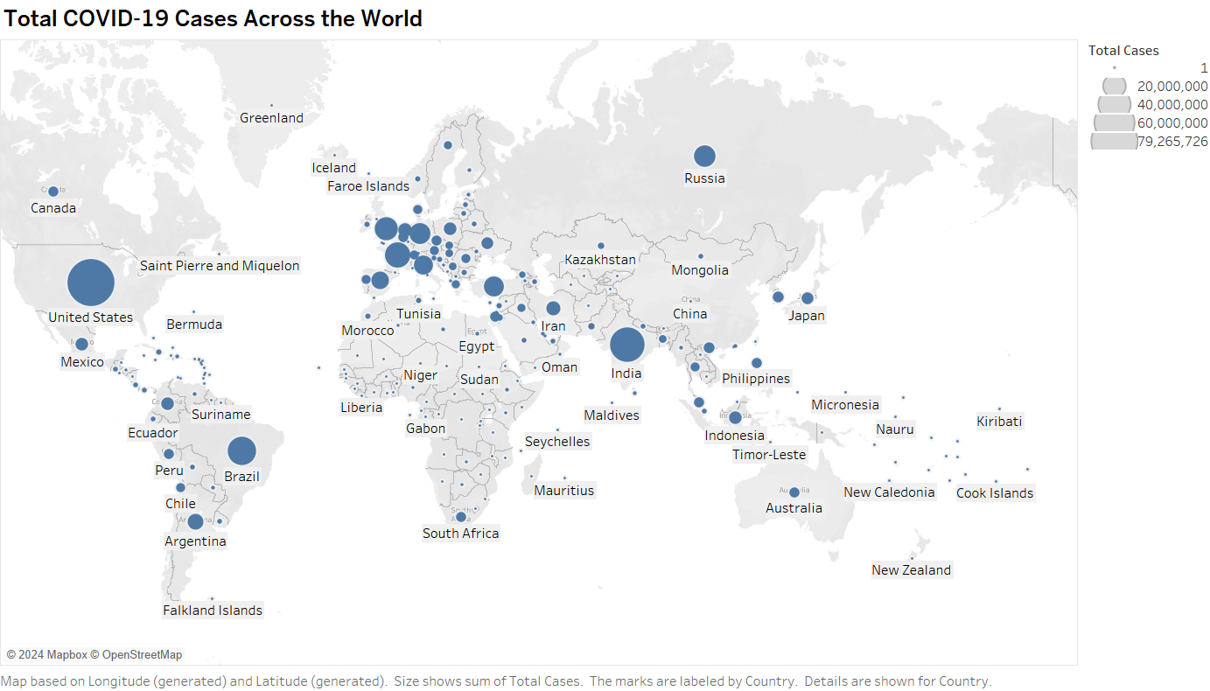
Graph-1: Total COVID-19 Cases Across the World

Slide 12
Graph-1: Total COVID-19 Cases Across the World
Interpretation:
The largest circles, indicating the highest numbers of cases, are prominently visible in countries like the United States, India, and Brazil, reflecting significant outbreaks.
Similarly in Europe as well whee countries like France Uk and germany can be noticed
Smaller circles are seen throughout Europe, Asia, and Africa, indicating a varied impact of the pandemic across different regions.
Africa has the least Impact of Covid 19 followed by oceania

Slide 13
Graph-2: Total COVID-19 deaths Across the World
Tool Used: Power BI
This geographic visualization maps the total number of COVID-19 deaths across the world, with countries represented as circles sized proportionally to the total cases they have reported.
Power BI is powerful for creating interactive BI reports and dashboards. Its integration with other Microsoft products enhances its utility for many businesses.

Slide 14
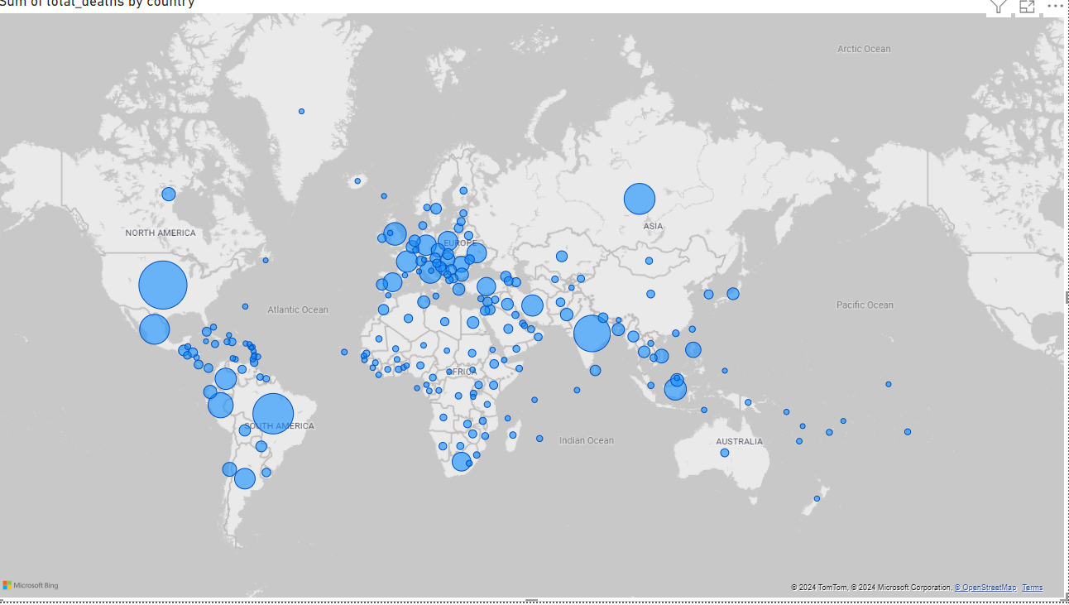
Graph-2: Total COVID-19 deaths Across the World

Slide 15
Graph-2: Total COVID-19 deaths Across the World
Interpretation:
Similar to the first graph, larger circles denote higher numbers of deaths, with significant visibility in the United States, Brazil, and India, countries that have also reported high case counts.

Slide 16
Graph-3: Comparison of Average Total COVID-19 Cases and Deaths per Million by Continent
Tool used: Python with Seaborn library
This pair of bar charts was created using the Seaborn library in Python, a popular data visualization library that provides a high-level interface for drawing attractive and informative statistical graphics.
The chart quantifies the average total cases of COVID-19 per million people by continent, with the y-axis representing the number of cases on a linear scale.
The chart quantifies the average total deaths of COVID-19 per million people by continent, with the y-axis representing the number of cases on a linear scale.

Slide 17
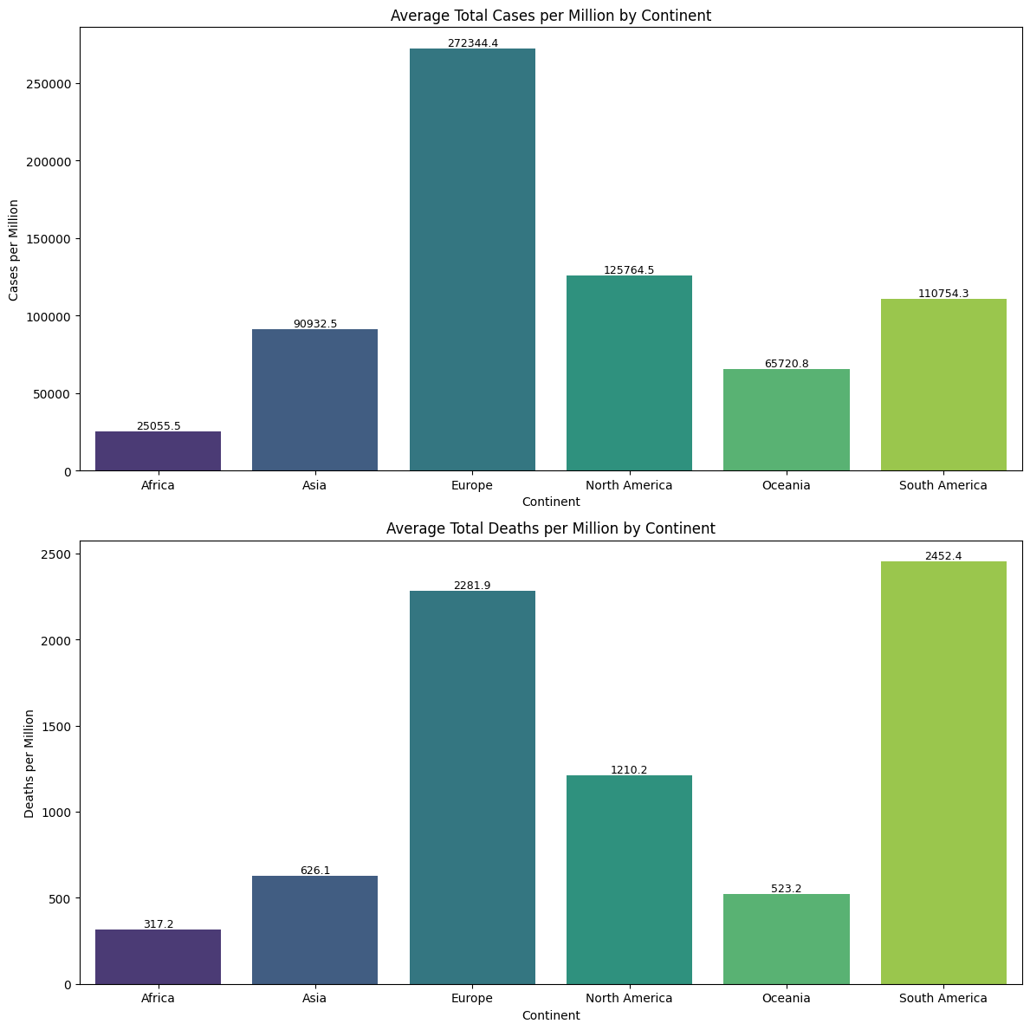
Graph-3: Comparison of Average Total COVID-19 Cases and Deaths per Million by Continent

Slide 18
Graph-3: Comparison of Average Total COVID-19 Cases and Deaths per Million by Continent
Interpretation:
Europe and North America exhibit significantly higher average cases per million compared to other continents, with Europe showing the highest.
Africa and Asia have comparatively lower figures
The numeric values atop each bar provide a precise measurement, emphasizing Europe's severe outbreak relative to its population size.
In Deaths, the distribution pattern slightly differs from the cases, with Europe and South America showing the highest deaths per million. This indicates not only high transmission rates but also varying mortality impacts, which could be influenced by healthcare infrastructure and demographic factors.
The visualization distinctly highlights the heavy impact in South America, which has a high death rate despite fewer cases per million than Europe

Slide 19
Graph-4: Comparison of Average Total COVID-19 Cases and Deaths by Country - TOP 10
Tool used: Python with Seaborn library
This bar chart visualizes the total number of COVID-19 cases and deaths for selected countries, using Seaborn for a clean and straightforward presentation
The chart differentiates between total cases (blue bars) and total deaths (red bars), providing a direct visual comparison of the impact in terms of both infection and fatality rates across the countries.
Each country is listed on the x-axis, with the total cases and deaths clearly labeled on the respective bars

Slide 20
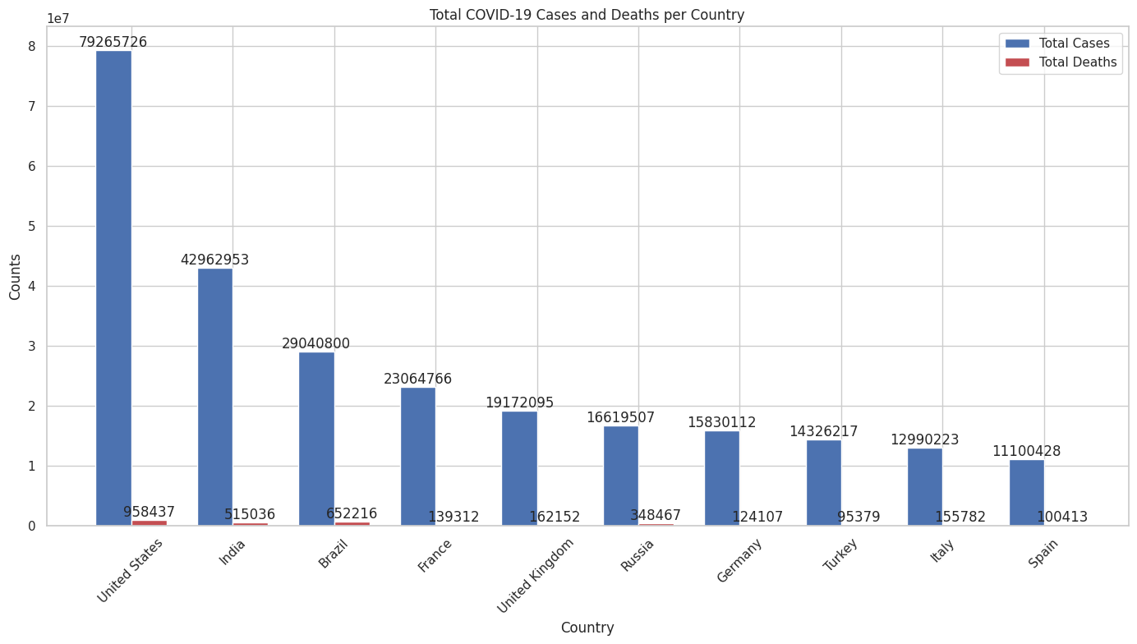
Graph-4: Comparison of Average Total COVID-19 Cases and Deaths by Country - TOP 10
The United States, India, and Brazil show the highest numbers in both categories, reflecting their significant struggles with the pandemic.

Slide 21
Graph-5: Comparison of Average Total COVID-19 Cases and Deaths per million by Country - TOP 10
Tool used: Python with Seaborn library
This set of horizontal bar charts provides a detailed breakdown of COVID-19 total cases and deaths per million by country, emphasizing the rate of infection and fatalities adjusted for population size.
Countries are sorted by cases per million from highest at the bottom to lowest at the top, facilitating a quick understanding of which countries have the highest relative infection rates and fatality rates

Slide 22
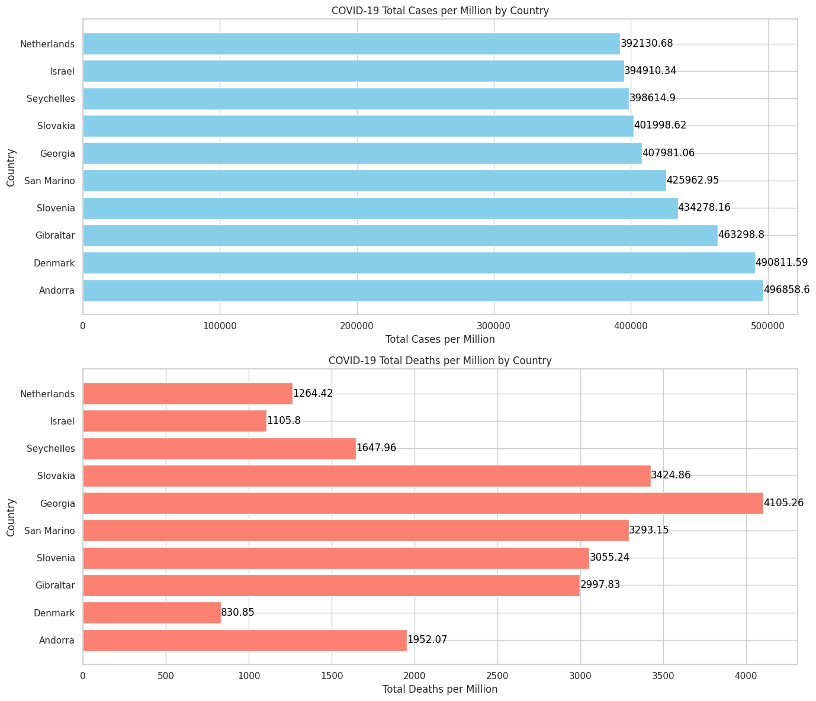
Graph-5: Comparison of Average Total COVID-19 Cases and Deaths per million by Country - TOP 10

Slide 23
Graph-5: Comparison of Average Total COVID-19 Cases and Deaths per million by Country - TOP 10
Some Countries reaching up to nearly 500,000 cases per million in some countries, highlighting severe outbreaks
This chart shows that countries like Andorra, Gibraltar, and San Marino have exceedingly high numbers of cases per million. These figures suggest extremely high transmission rates within these small populations
In Deaths, notably, San Marino, Belgium, and Slovenia appear with high death rates per million, suggesting that while the transmission was high, the death rate also reflects significant challenges in managing the disease's severity among populations.
The disparities between the cases and deaths can be indicative of different healthcare system efficiencies

Slide 24
Graph-6: Total Deaths and Total Deaths per Million by GDP of the Country
Tool used: Tableau
This scatter plot displays the relationship between a country's GDP per capita and its COVID-19 related total deaths and deaths per million.
Each point represents a country, labeled by its ISO code, with the x-axis indicating total deaths and the y-axis showing GDP per capita.
The size of each point reflects the number of total deaths per million, providing a multi-dimensional analysis of the economic impact versus the health impact.

Slide 25
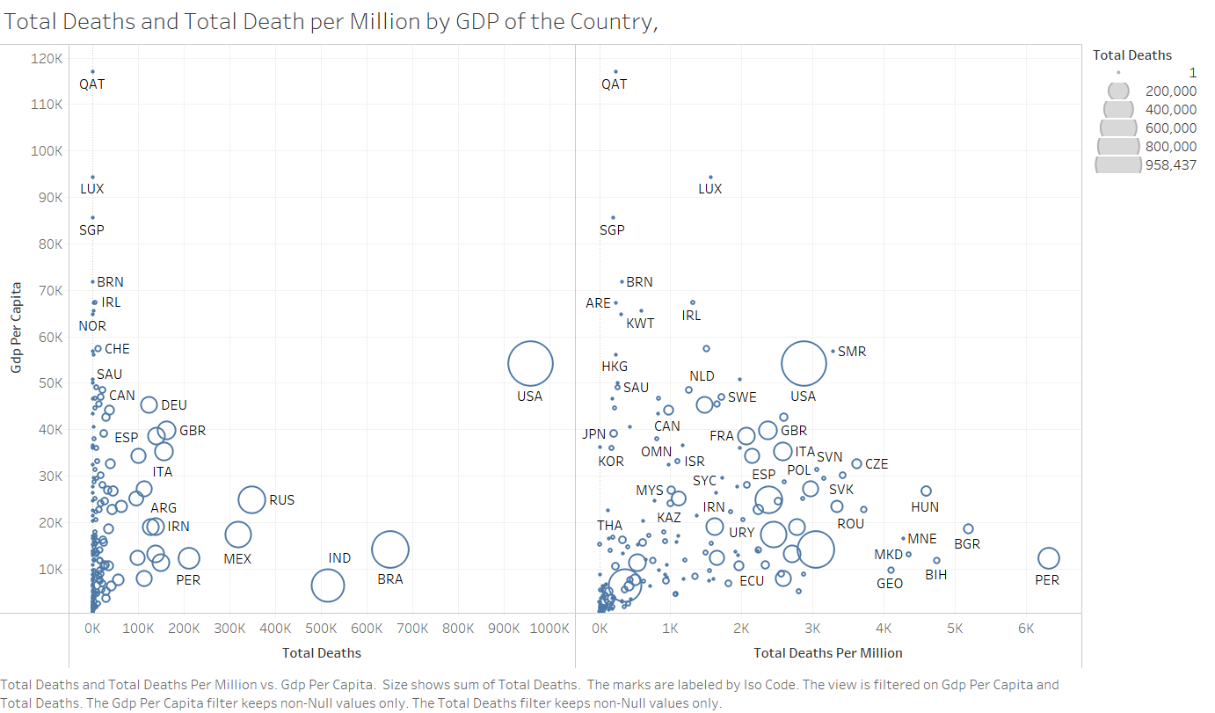
Graph-6: Total Deaths and Total Deaths per Million by GDP of the Country

Slide 26
Graph-6: Total Deaths and Total Deaths per Million by GDP of the Country
Interpretation:
Wealthier nations (higher GDP per capita), such as Luxembourg and Singapore, tend to have higher total deaths but relatively lower deaths per million, suggesting better overall healthcare systems capable of managing the severity per capita.
The USA stands out with a high number of total deaths and a significant size indicating deaths per million, despite a high GDP per capita, highlighting challenges in pandemic management.
Countries with lower GDP per capita like India and Brazil show a large number of total deaths with a high rate per million, indicating severe impacts compounded by economic challenges.

Slide 27
Graph-7: Total Deaths and Deaths per Million vs. Density and Density per Mile
Tool used: Tableau
This complex visualization compares total deaths and deaths per million against population density and density per mile.
The y-axis indicates the population density, while the x-axis shows total deaths.
The size of each point represents deaths per million, and the points are labeled by country.

Slide 28
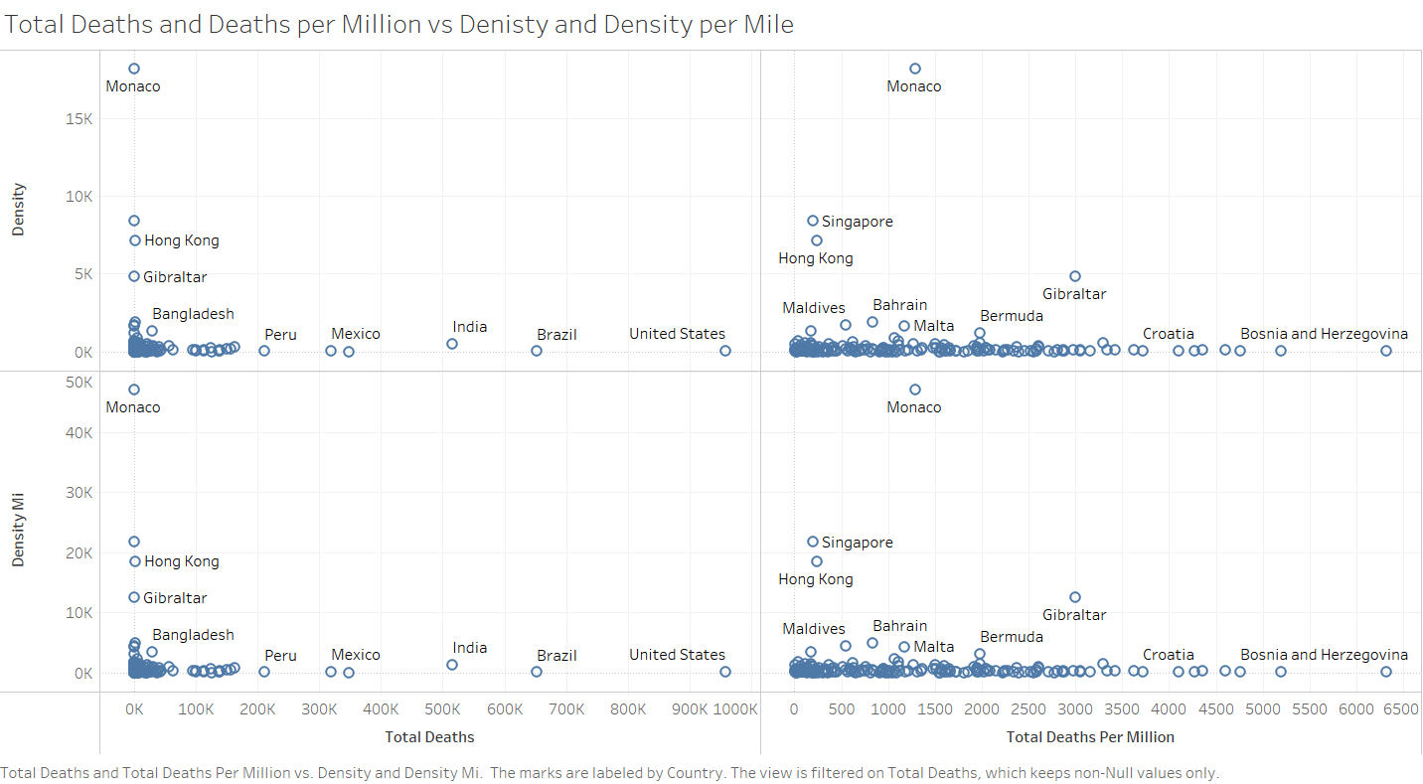
Graph-7: Total Deaths and Deaths per Million vs. Density and Density per Mile

Slide 29
Graph-7: Total Deaths and Deaths per Million vs. Density and Density per Mile
Interpretation:
Countries with high density such as Bangladesh and India show a large number of total deaths but relatively smaller deaths per million, suggesting that while the absolute numbers are high, the death rate relative to the density is managed.
Conversely, smaller countries or regions like Monaco and Singapore, with high densities, have managed to keep both absolute and per million deaths relatively lower, likely due to effective containment and healthcare strategies.
This graph helps visualize the challenge of managing COVID-19 in densely populated areas.

Slide 30
Graph-8: Median Age vs. Total Deaths per Million
Tool used: Tableau
This scatter plot explores the relationship between the median age of a country’s population and its COVID-19 death rates per million.
The x-axis shows the median age, and the y-axis shows total deaths per million.
The size of each point indicates the percentage of the population aged 65 or older, providing insight into how age demographics affect COVID-19 mortality rates.

Slide 31
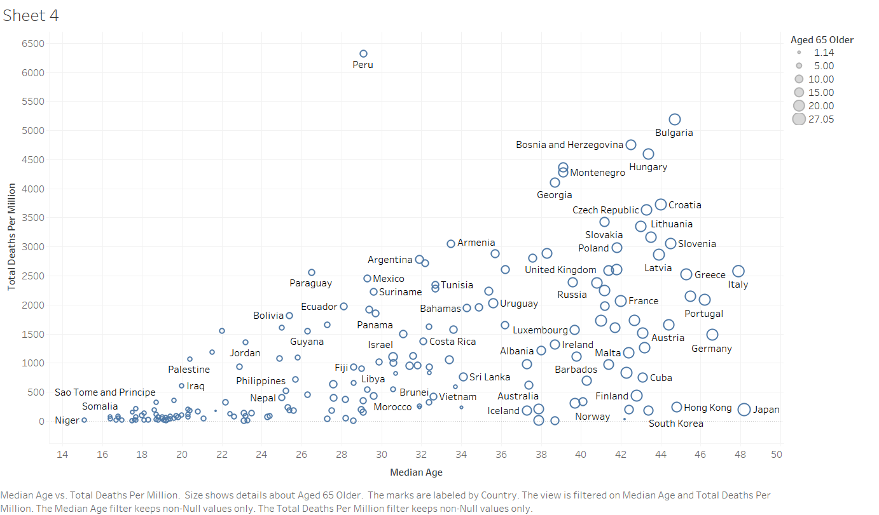
Graph-8: Median Age vs. Total Deaths per Million

Slide 32
Graph-8: Median Age vs. Total Deaths per Million
Interpretation:
Countries with older populations (higher median age and larger percentage of aged 65 or older), such as Italy, Portugal, and Germany, have higher deaths per million, underscoring the vulnerability of older individuals to COVID-19.
Countries with younger populations like Nepal and Iraq have significantly lower death rates per million, highlighting the protective effect of a younger demographic against severe outcomes.
The scatter plot effectively shows the correlation between age demographics and COVID-19 mortality, important for healthcare planning and resource allocation.

Slide 33
Conclusion
Economic Impact: There is a notable correlation between a country's economic status (GDP per capita) and its ability to manage the health outcomes of its population, with wealthier countries generally showing better management per capita.
Demographic Challenges: Age demographics significantly influence COVID-19 mortality rates, with older populations experiencing higher death rates. This underscores the importance of targeted protective measures for older communities.
Density and Spread: High-density countries face unique challenges in controlling the spread of COVID-19, but effective management strategies can mitigate these challenges, as seen in some high-density but low mortality regions.

Slide 34
5. References
1. https://www.kaggle.com/datasets/rajkumarpandey02/2023-world-population-by-country
2. https://www.kaggle.com/datasets/georgesaavedra/covid19-dataset

Slide 35
THANK YOU

